Slide 1
Capstone Project
Credit Card Default Prediction By Krushna Chaure Data Science Trainee AlmaBetter,Bangalore

Slide 2
Topic for Discussion
1. Introduction
2. Problem Statement
3. Understand Dataset
4. Null Values/Missing Values Treatment & Data Wrangling
5. EDA (Exploratory Data Analysis)
(a) Univariate
(b) Bivariate
(c) Multivariate
6. Hypothesis Testing
7. Feature Engineering & Data Preprocessing
8. ML Model Implementation
(a) Logistic Regression
(b) Decision Tree Regressor
(c) Support Vector Machine(SVM)
(d) Random Forest Classifier
(e) XGBoost Classifier
9. Challenges Faced
10. Conclusion

Slide 3
Introduction
Credit card default prediction is an important problem for credit card companies as it helps them minimize their financial risks and improve their profitability. Default occurs when a borrower fails to repay their outstanding balance for an extended period, leading to significant financial losses for credit card issuers. Predicting credit card defaults is a complex problem that requires careful data preparation and modeling. In recent years, machine learning techniques have been used to develop accurate models that help credit card issuers identify risky borrowers and take proactive measures to prevent defaults. In this project, we will explore the process of credit card default prediction using the Credit Card Default Dataset from the UCI Machine Learning Repository. We will perform data cleaning, exploratory data analysis, feature engineering, and modeling to train and test various classification algorithms. The goal of this project is to build accurate models that help credit card issuers minimize their financial risks and improve their profitability.

Slide 4
Problem Statement
The problem of credit card default prediction is to develop a model that can accurately predict whether a credit card client is likely to default or not. This is a binary classification problem where the target variable is a binary variable indicating whether a client has defaulted or not. The goal of this problem is to help credit card issuers identify risky borrowers and take proactive measures to prevent defaults. Default can lead to significant financial losses for credit card companies, so accurately predicting defaults is essential for managing financial risks and improving profitability.

Slide 5
Understand Dataset
The Credit Card Default Dataset used for credit card default prediction contains information on credit card clients in Taiwan from April 2005 to September 2005. The dataset has 30,000 records and 24 features. The target variable is a binary variable indicating whether a client has defaulted or not. This research employed a binary variable, default payment (Yes = 1, No = 0), as the response variable. This study reviewed the literature and used the following 23 variables as explanatory variables:
ID: ID of each client
LIMIT_BAL: Amount of given credit in NT dollars (includes individual and family/supplementary credit)
SEX: Gender (1 = male, 2 = female)
EDUCATION: (1 = graduate school, 2 = university, 3 = high school, 0,4,5,6 = others)
MARRIAGE: Marital status (0 = others, 1 = married, 2 = single, 3 = others)
AGE: Age in years
X6 - X11: History of past payment. We tracked the past monthly payment records (from April to September, 2005) as follows: X6 = the repayment status in September, 2005; X7 = the repayment status in August, 2005; . . .;X11 = the repayment status in April, 2005. The measurement scale for the repayment status is: -1 = pay duly; 1 = payment delay for one month; 2 = payment delay for two months; . . .; 8 = payment delay for eight months; 9 = payment delay for nine months and above.
X12-X17: Amount of bill statement (NT dollar). X12 = amount of bill statement in September, 2005; X13 = amount of bill statement in August, 2005; . . .; X17 = amount of bill statement in April, 2005.
X18-X23: Amount of previous payment (NT dollar). X18 = amount paid in September, 2005; X19 = amount paid in August, 2005; . . .;X23 = amount paid in April, 2005.

Slide 6
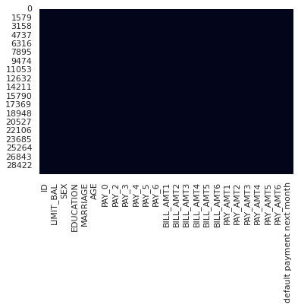
Null Values/Missing Values Treatment & Data Wrangling
The dataset has 30000 rows and 25 columns. There are no mising values and duplicate values in the dataset. Changing name of some columns for simplicity and better understanding.

Slide 7
EDA (Exploratory Data Analysis)
Here we understand the relationships between variables where Exploratory Data Analysis (EDA) is an approach to analyze the data using visual techniques. It is used to discover trends, patterns, or to check assumptions with the help of statistical summary and graphical representations.
We analysis into 3 types:-
1. Univariate Analysis:-
Univariate analysis explores each variable in a data set, separately. Uni means one, so in other words the data has only one variable. Univariate data requires to analyze each variable separately.
2. Bivariate Analysis:-
Bivariate analysis is one of the statistical analysis where two variables are observed. here we analyze the changes occured between the two variables and to what extent.
3. Multivariate Analysis:-
Multivariate analysis (MVA) involves evaluating multiple variables (more than two) to identify any possible association among them.

Slide 8
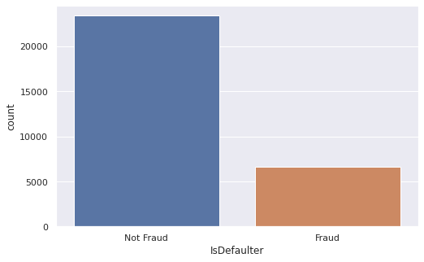
Univariate – No of Defaulter & Non Defaulter
From count plot we can see that, Defaulters is 23364 which are less as compare to the Non-Defaulters which is 6636 in the given dataset.And also we can see that both classes are not in proportion that is we have an imbalanced dataset.

Slide 9
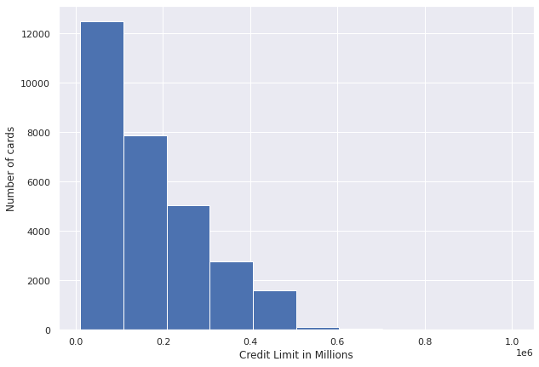
Univariate – Distribution of balance limit of card
from histogram we can see that limit balance feature is right skewed, almost 70% of value lie between 10K to 200k. few of limit goes beyond 500k taiwan dollar

Slide 10
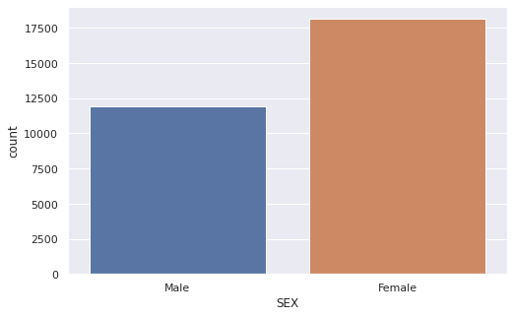
Univariate – Credit Card Consumer According To Gender
From count plot we can see that, Female credit card consumer more as compared to male credit card consumer in our dataset.

Slide 11
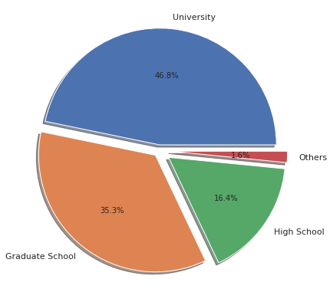
Univariate – Education of The Card Holder
so here 5, 6, 0 are unknown inforamtion so we mege it with 4(other) category. From pie chart we can see that:- University and Graduate School has maximum credit card holder which is 46.8 % and 35.3 % respectively. High school have 16.4 % credit card holder and only 1.6 % Other credit card holder

Slide 12
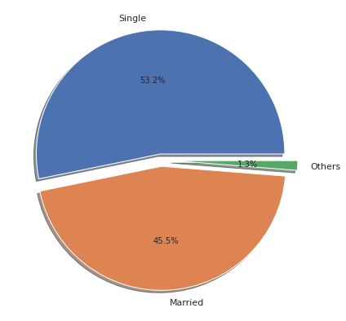
Univariate – Marital Status of Credit Card Holder
so here we merge 0 and 3 to the other category. From above pie chart we can see that:- Number of credit card holder is maximum in singles which is 53.2 %. Number of credit card holder Married is 45.5 %. There are only 1.3 % Other credit card holder which might be chances to divorced or another reason.

Slide 13
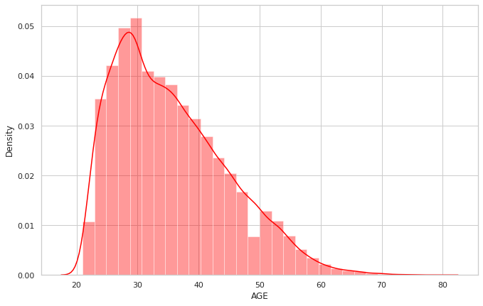
Univariate – Age Distribution of Credit Card Holder
From Distplot we can see that:- Age feature is also right skewed, middle 50% of age is 22 to 42 years which means mostly working class people use credit card. Few people above 60 years of age also uses the credit card.

Slide 14
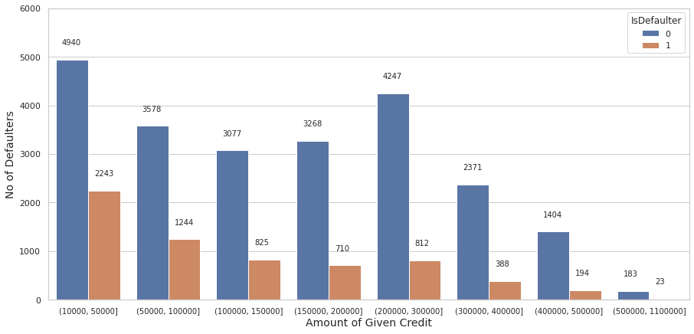
Bivariate - Defaulter With Different Range of Credit Balance Limit
From countplot we can see that:- There are almost 60 % which is 3487 defaulter come between 10000 to 100000 Credit card balance limit We also can see that the higher the credit card balance limit, the lower is the chance of defaulting.

Slide 15
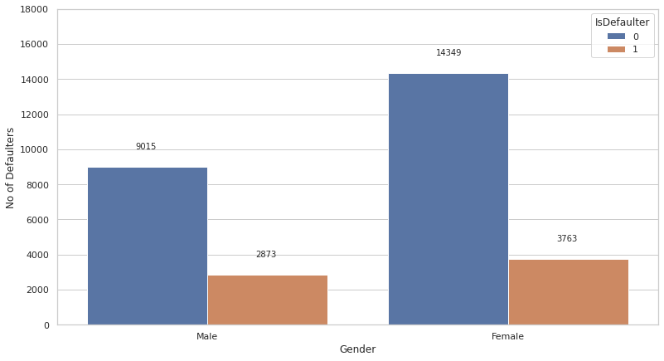
Bivariate - Defaulter According To Different Genders
From countplot we can see that:- There are more women than men in our dataset because of this their defaulter value is more which is 3763 and their percentage of dafaulter is 20 %. There are less men compare to women in our dataset because of this their defaulter value is less which is 2873 but their percentage of dafaulter is 24 %. So comparitively men have a slightly higher chance of default.

Slide 16
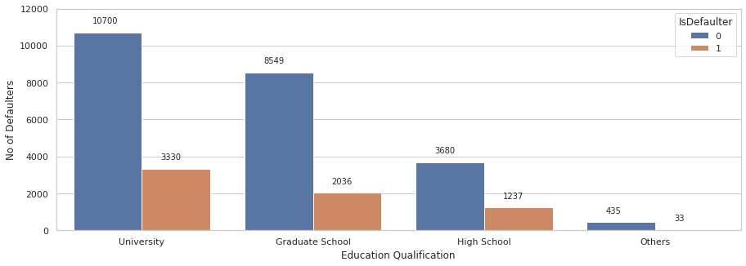
Bivariate - Defaulter According Education
From countplot we can see that:- As the number of university and graduate school credit card holder is higher which is 10700 & 8549. also their credit card default are also higher which is 3330 & 2036. High school have less Credit card holder which is 3680 so their defaulter is less which is 1237. Other have very less credit card holder which is 435 so their defauler is very less which is 33.

Slide 17
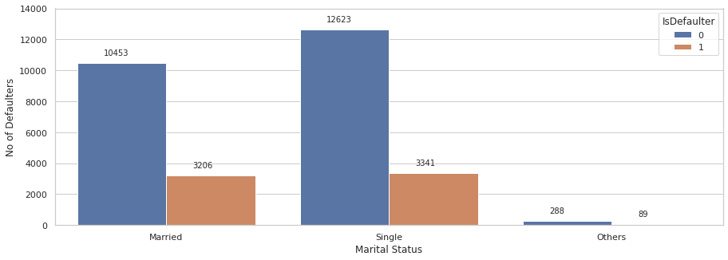
Bivariate - Defaulter According Marital Status
From countplot we can see that:- Number of credit card holder is maximum in singles as compare to married which is 12623 in single & 10453 in married but credit card defaulter are almost same in case of single and married people which is 3341 in single & 3206 in married. Other people have less credit card holder so their defaulter is less which is only 89.

Slide 18
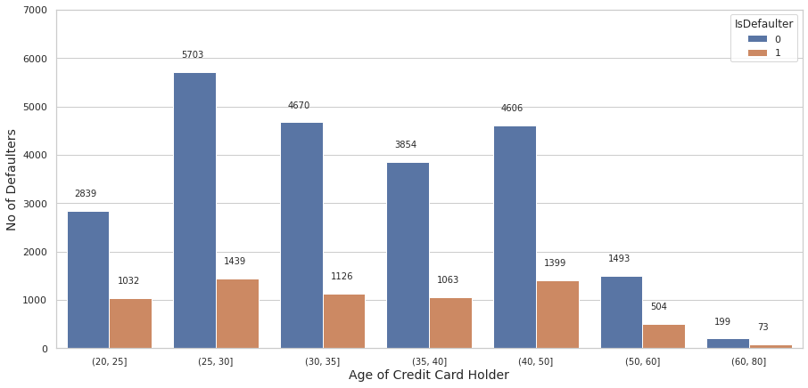
Bivariate - Defaulter According To Different Ages
From countplot we can see that:- Most of the defaulter cases happen in 25 to 30 age group which is 1439 dafaulter with 25 % defaulter ratio and 40 to 50 age group which is 1399 dafaulter with 30 % dafaulter ratio. Age group 30 to 40 have 2189 defaulter with 25 % defaulter ratio. Age group(20 to 25 & 50 to 60 & 60 to 80) have less credit card holder and their defaulter is 1609 but their defaulter ratio is high which is 35 %.

Slide 19
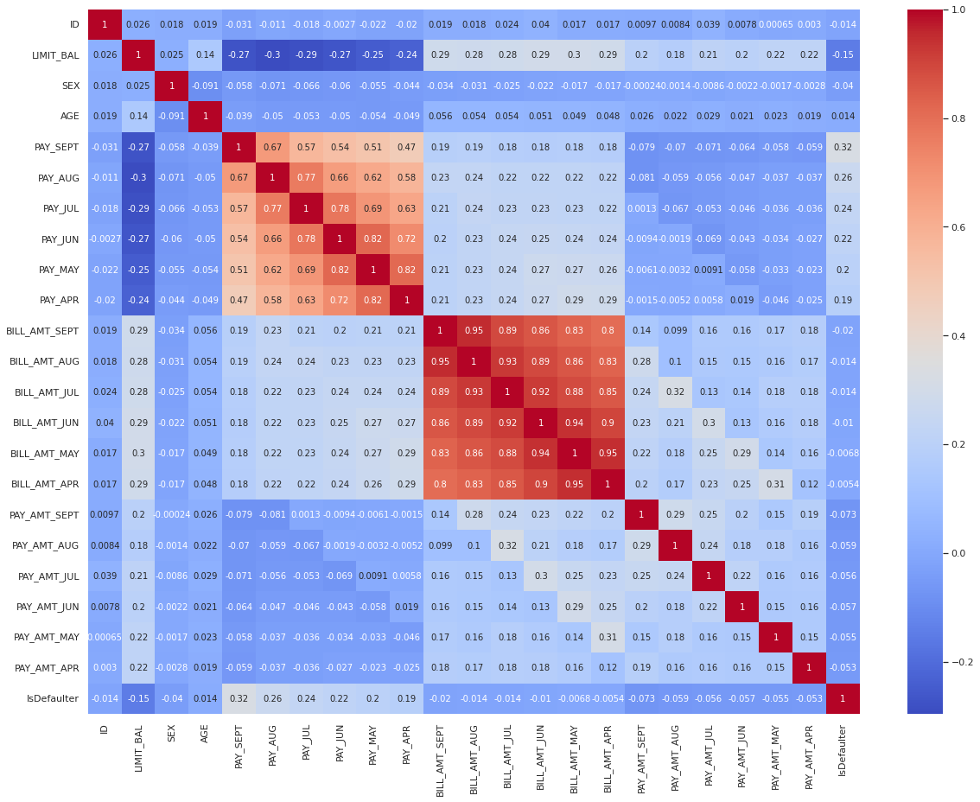
Multivariate – Correlation Heatmap
From Heatmap we can see that:- There are highly correlation between bill amount column and also there are highly correlation between pay amount column. except bill amount and pay amount column there are no any highly correlation between column.

Slide 20
Hypothesis Testing
Hypothesis Testing is a type of statistical analysis in which you put your assumptions about a population parameter to the test. the theory, methods, and practice of testing a hypothesis by comparing it with the null hypothesis. The null hypothesis is only rejected if its probability falls below a predetermined significance level, in which case the hypothesis being tested is said to have that level of significance.
Hypothesis testing - 1
Q :- Customers not Default when Amount of given credit in NT dollars is above 100000
Ans :- I have used t-Test as the statistical testing to obtain P-Value and found the result that Null hypothesis has been rejected.
we got probability of 0.0 so Customers also Default when Amount of given credit in NT dollars is above 100000 thats why we reject them.
Also mean is greater than median over -40109. So, the distribution is rightly skewed. For a skewed data Z-Test can't be performed.

Slide 21
Feature Engineering & Data Preprocessing
Feature engineering is the pre-processing step of machine learning, which is used to transform raw data into features that can be used for creating a predictive model using Machine learning or statistical Modelling. Feature engineering in machine learning aims to improve the performance of models.
SMOTE(Synthetic Minority Oversampling Technique):-
SMOTE is an oversampling technique where the synthetic samples are generated for the minority class. This algorithm helps to overcome the overfitting problem posed by random oversampling.
Scaling:-
Feature scaling is the process of normalising the range of features in a dataset. It is performed during the data pre-processing to handle highly varying magnitudes or values or units. If feature scaling is not done, then a machine learning algorithm tends to weigh greater values, higher and consider smaller values as the lower values, regardless of the unit of the values.

Slide 22
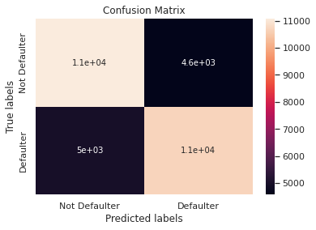
ML Model – Logistic Regression
Logistic regression is a data analysis technique that uses mathematics to find the relationships between two data factors.It is used to calculate or predict the probability of a binary (yes/no) event occurring.
We have implemented logistic regression and we getting scores nearly 69% for all and f1-sore approx 69% which say that model is not as much accurate that we want. As we have imbalanced dataset, F1- score is better parameter.The logistic regression model did a good job accurately predicting when a client would not default, but did not do very well predicting when a client would default.

Slide 23
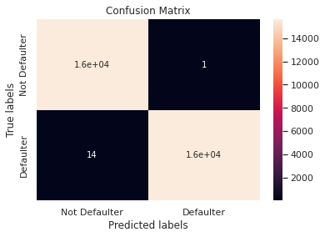
ML Model – Decision Tree Classifier
The decision tree classifier (Pang-Ning et al., 2006) creates the classification model by building a decision tree. Each node in the tree specifies a test on an attribute, each branch descending from that node corresponds to one of the possible values for that attribute. Some advantages of decision trees are that they require less data preprocessing, i.e., no need to normalize features. However, noisy data can be easily overfitted and results in biased results when the data set is imbalanced.
We have implemented Decision Tree Classifier and we getting scores nearly 80% for all and f1-sore approx 79%. As we have imbalanced dataset, F1- score is better parameter. also accuracy score is 99% on training dataset which leads to say that Decision Tree Classifier is overfitted. The Decision Tree Classifier model did a good job accurately predicting when a client would not default, also do very well predicting when a client would default.

Slide 24

ML Model – Support Vector Machine(SVM)
Support Vector Machine(SVM) is a supervised machine learning algorithm used for both classification and regression. Though we say regression problems as well its best suited for classification. The objective of SVM algorithm is to find a hyperplane in an N-dimensional space that distinctly classifies the data points.
We have implemented Support Vector Machine(SVM) and we getting scores nearly 77% all and f1-sore approx 75% which is averagely good. As we have imbalanced dataset, F1- score is better parameter. The Support Vector Machine(SVM) model did a good job accurately predicting when a client would not default, but did not do very well predicting when a client would default.

Slide 25

ML Model – Random Forest Classifier
Random Forest is a classifier that contains a number of decision trees on various subsets of the given dataset and takes the average to improve the predictive accuracy of that dataset." Instead of relying on one decision tree, the random forest takes the prediction from each tree and based on the majority votes of predictions, and it predicts the final output.
We have implemented Random Forest Classifier and we are getting around 99% train accuracy and 86% for test accuracy which depicts that model is overfitting. However our f1-score is around 86%, which is not bad.Then we implemented hyperparameter tuning and we are getting around 99% train accuracy and 86% for test accuracy even after we use hyperparameter gridsearchcv the model will not get accuracy which depicts that model is overfitting. However our f1-score is still around 86% after using hyperparameter gridsearchcv which is not bad.The Random Forest Classifier model did a good job accurately predicting when a client would not default, also do very well predicting when a client would default.

Slide 26

ML Model – XGBoost Classifier
XGBoost (Extreme Gradient Boosting) is an optimized distributed gradient boosting library. It uses gradient boosting (GBM) framework at core. It belongs to a family of boosting algorithms that convert weak learners into strong learners. A weak learner is one which is slightly better than random guessing.
Boosting' here is a sequential process; i.e., trees are grown using the information from a previously grown tree one after the other. This process slowly learns from data and tries to improve its prediction in the subsequent iterations.
XGBoost (eXtreme Gradient Boosting) is a popular supervised-learning algorithm used for regression and classification on large datasets. It uses sequentially-built shallow decision trees to provide accurate results and a highly-scalable training method that avoids overfitting.
We have implemented XGBoost Classifier and we are getting around 91% train accuracy and 85% for test accuracy which depicts that model is very good. However our f1-score is around 84%, which is not bad.Then we implemented hyperparameter tuning and we are getting around 99% train accuracy and 87% for test accuracy after we use hyperparameter gridsearchcv the model will not get accuracy which depicts that model is overfitting, so hyperparameter tuning is not helpfull in XGBoost Classifier to get good model. However our f1-score is still around 86% after using hyperparameter gridsearchcv which is not bad.The XGBoost Classifier model did a good job accurately predicting when a client would not default, also do very well predicting when a client would default.

Slide 27
Challenges Faced
Imbalanced data: In credit card default prediction, the number of customers who default on their payments is often much smaller than the number of customers who do not default. This can result in imbalanced data, which can lead to biased models and inaccurate predictions.
Data quality: The quality of the data used in credit card default prediction is crucial. Data that is incomplete, inaccurate, or outdated can lead to erroneous predictions.
Feature selection: Identifying the most important features or variables that influence credit card default is a challenge. There may be many variables to consider, and it can be difficult to determine which ones are most relevant.
Overfitting: Overfitting occurs when a model is too complex and fits the training data too closely, resulting in poor performance on new data. This can be a challenge in credit card default prediction, as there are many variables to consider and it is easy to overfit the model.
Changing customer behavior: Customer behavior can change over time, making it difficult to predict credit card default. Economic conditions, job loss, and unexpected events can all impact a customer's ability to make payments on time.
Interpretability: It is important for credit card default prediction models to be interpretable so that financial institutions can understand how the model makes its predictions. However, some machine learning algorithms may be difficult to interpret, making it challenging to explain how the model arrived at its predictions.

Slide 28
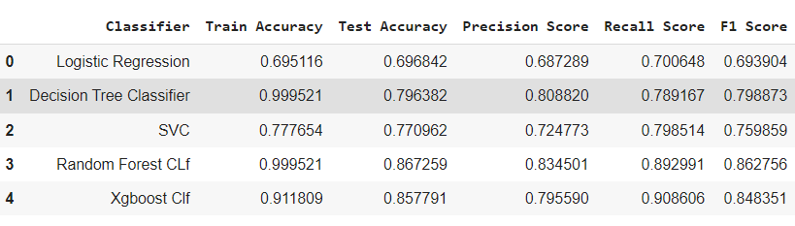
Conclusion
Credit history is a significant factor in predicting default. Those with a poor credit history are more likely to default on their credit card payments.
Other factors such as income level, age, and employment status also play a role in predicting default. For example, those with low income or unstable employment may be more likely to default.
In order to improve the accuracy of credit card default prediction models, it is important to continually update the models with new data and adjust the weighting of different factors based on their predictive power.
Credit card default prediction is a complex problem that requires careful data cleaning, exploratory data analysis, feature engineering, and modeling. By using various statistical and machine learning techniques we found that XGBoost (without hyperparameter tuning) is most accurate among all,hence we can build accurate models that help credit card issuers minimize their financial risks and improve their profitability.

Slide 29
Thank You

